Slide 1

SQL Project
Amazon sales
Case Study
PRESENTED BY:
Atul Pachauri

Slide 2
Objective
The major aim of this project is to gain insight into the sales data of Amazon to understand the different factors that affect sales of the different branches.

Slide 3
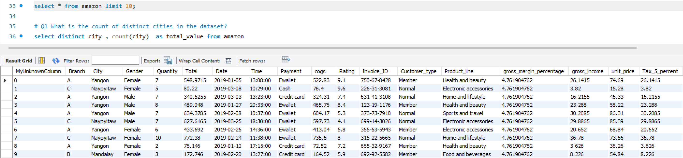
About Data
This dataset contains sales transactions from three different branches of Amazon, respectively located in Mandalay, Yangon and Naypyitaw. The data contains 18 columns and 1000 rows:

Slide 4
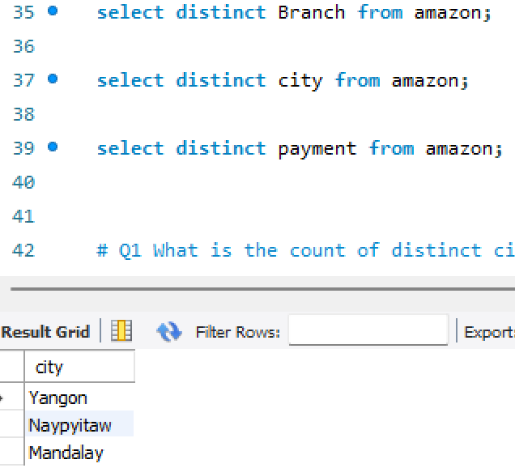
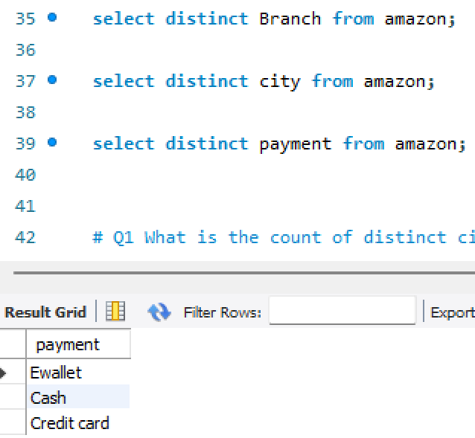
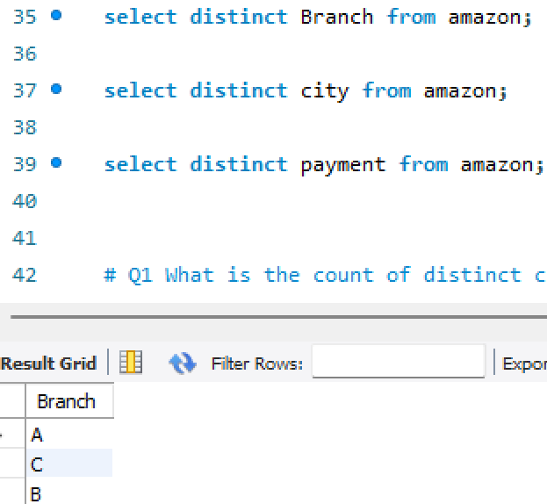
Explore Dataset
Branches: A, B and C
City: Mandalay, Yangon and Naypyitaw
Payment Method: E-Wallet, Cash and credit card

Slide 5
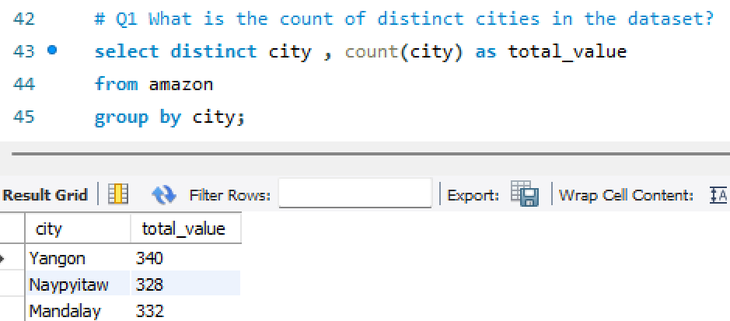
What is the count of distinct cities in the dataset?

Slide 6
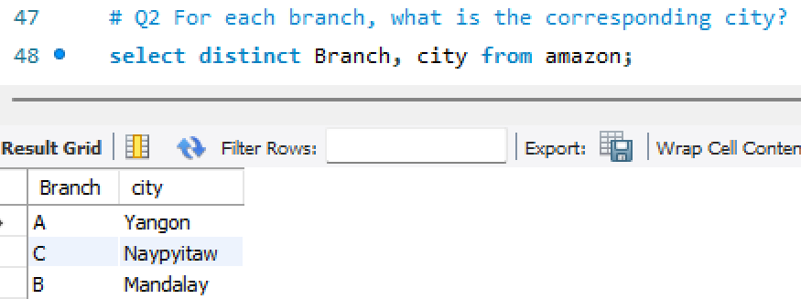
For each branch, what is the corresponding city?

Slide 7
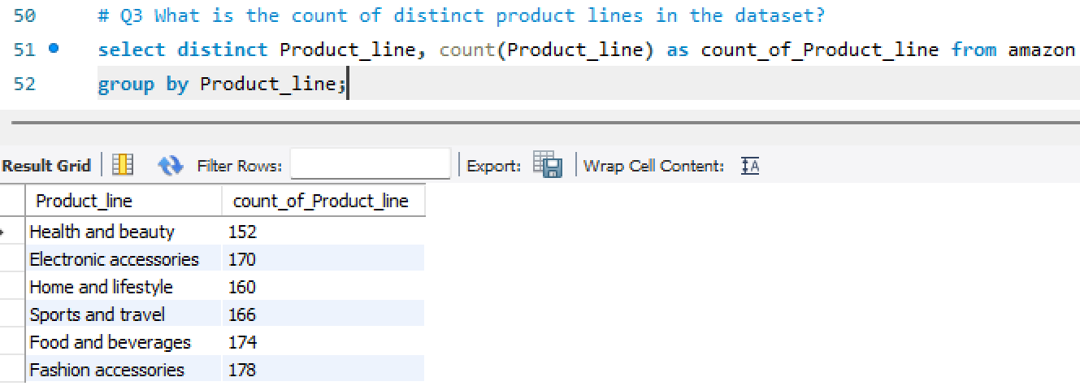
What is the count of distinct product lines in the dataset?

Slide 8
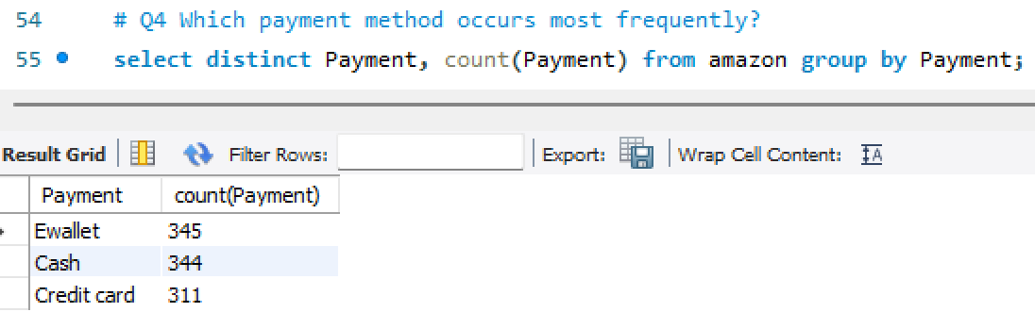
Which payment method occurs most frequently?

Slide 9
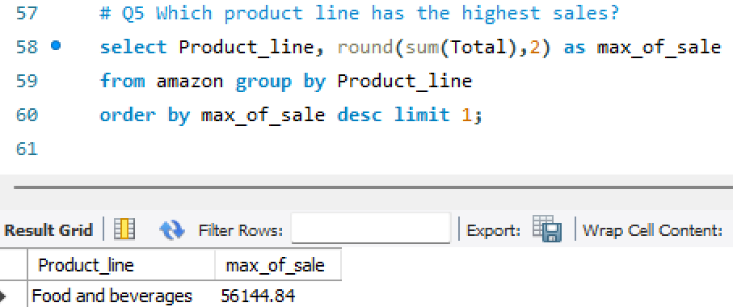
Which product line has the highest sales?

Slide 10
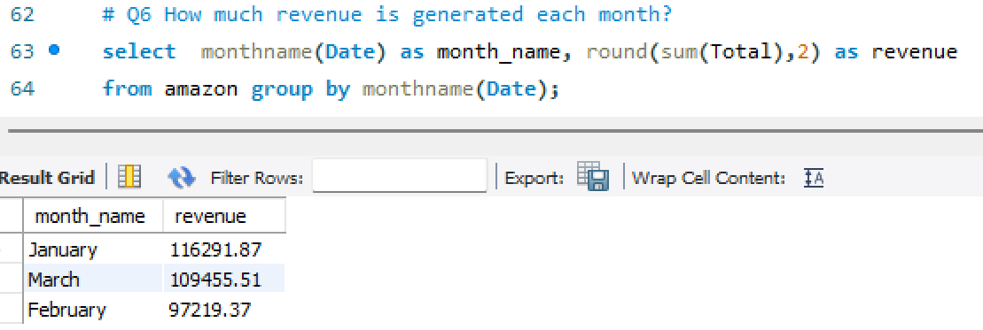
How much revenue is generated each month?

Slide 11
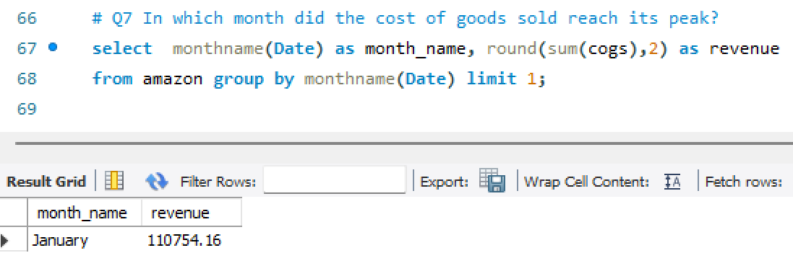
In which month did the cost of goods sold reach its peak?

Slide 12
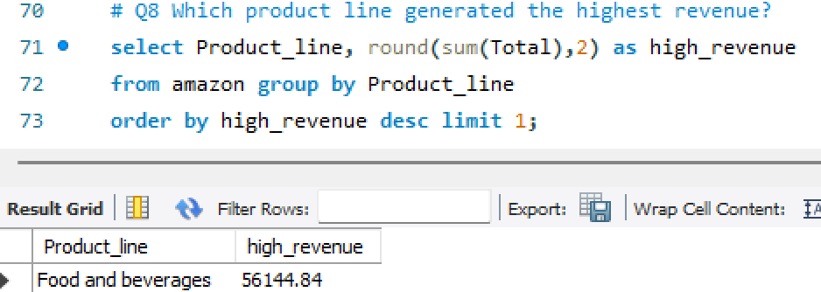
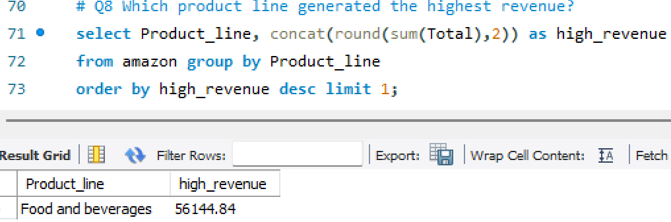
Which product line generated the highest revenue?

Slide 13
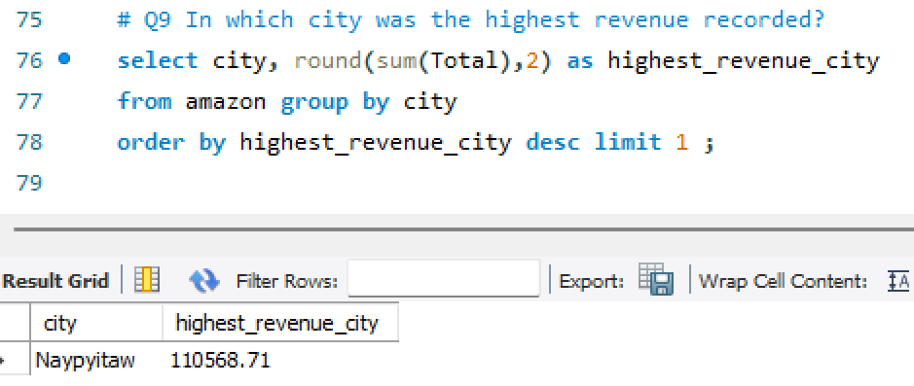
In which city was the highest revenue recorded?

Slide 14
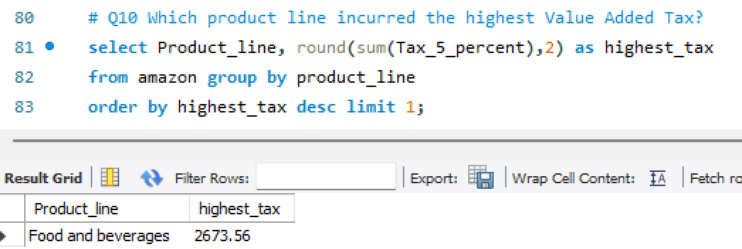
Which product line incurred the highest Value Added Tax?

Slide 15
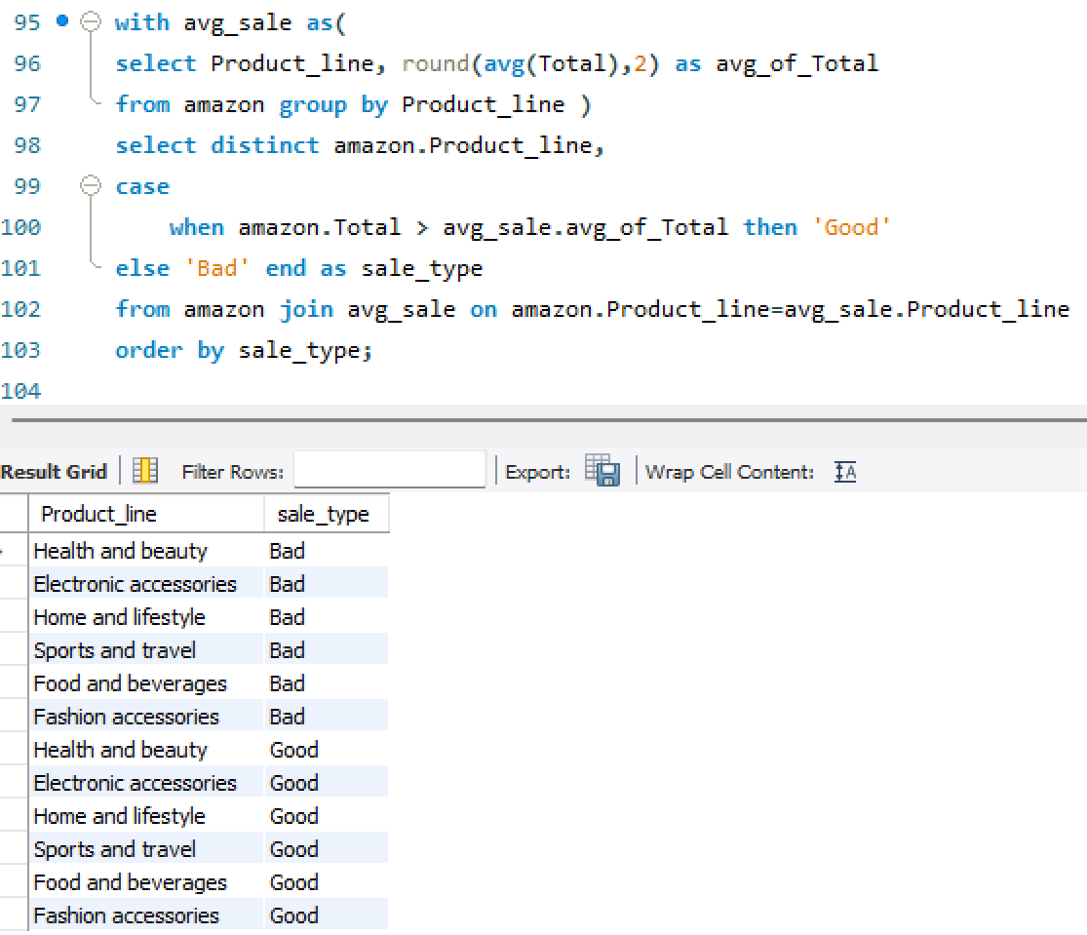
For each product line, add a column indicating "Good" if its sales are above average, otherwise "Bad."

Slide 16
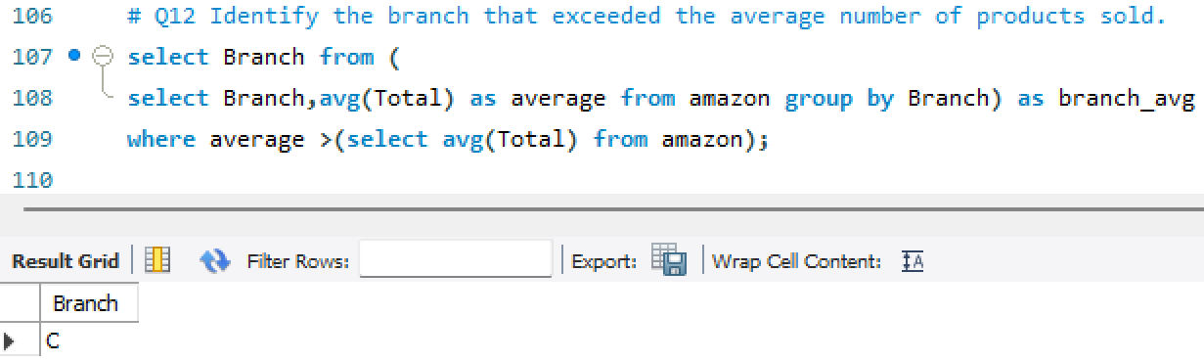
Identify the branch that exceeded the average number of products sold.

Slide 17
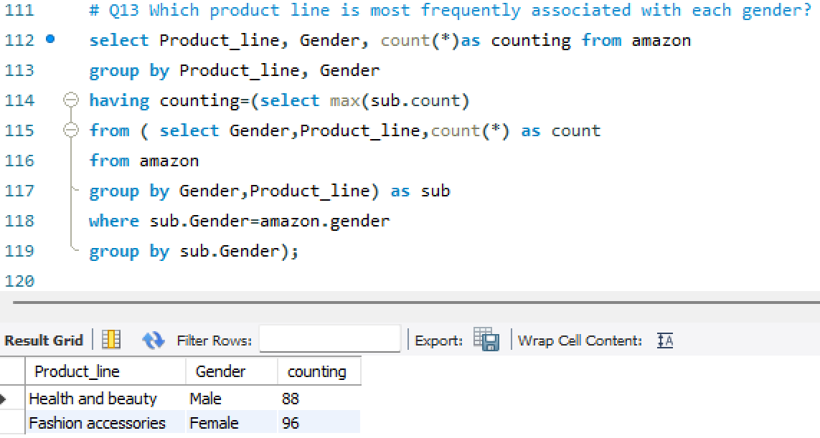
Which product line is most frequently associated with each gender?

Slide 18
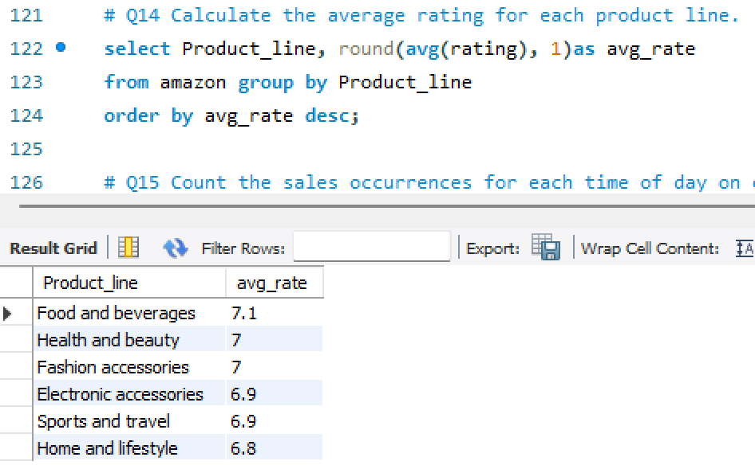
Calculate the average rating for each product line.

Slide 19
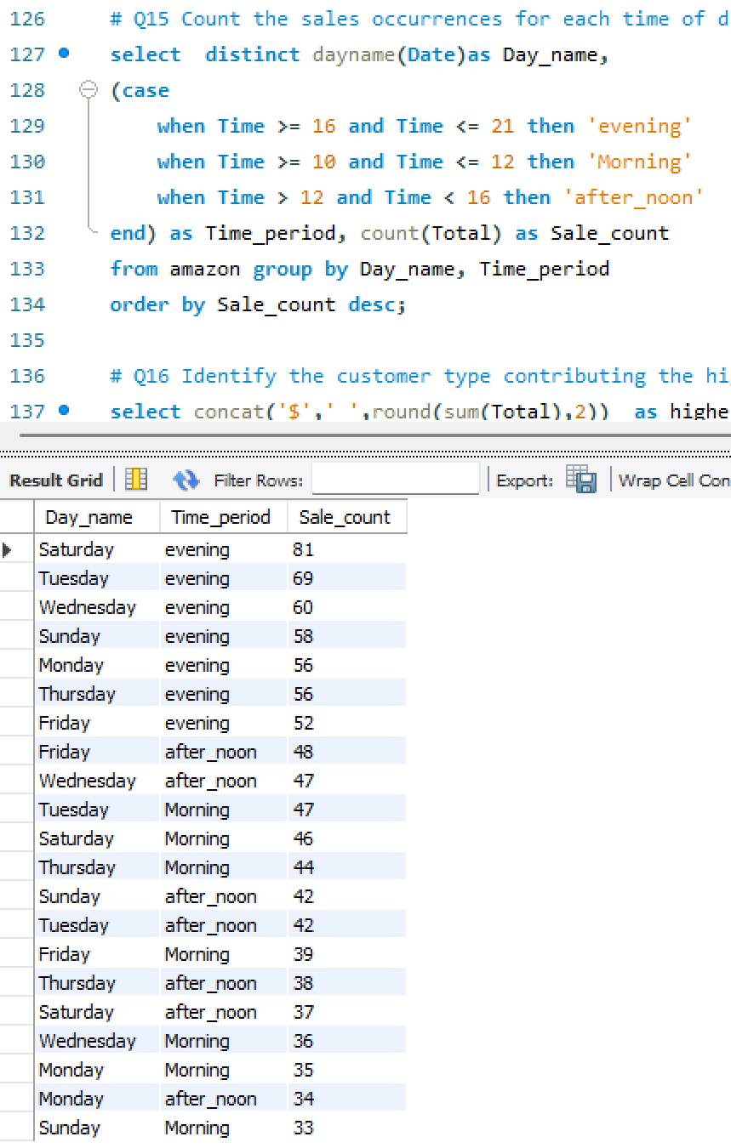
Count the sales occurrences for each time of day on every weekday.

Slide 20
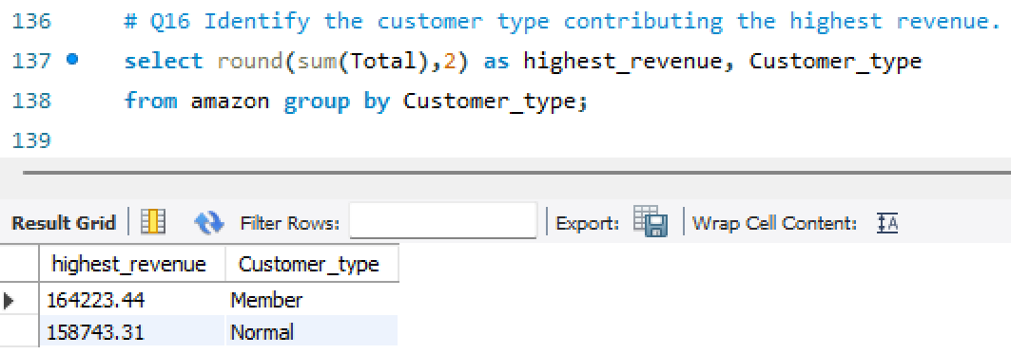
Identify the customer type contributing the highest revenue.

Slide 21
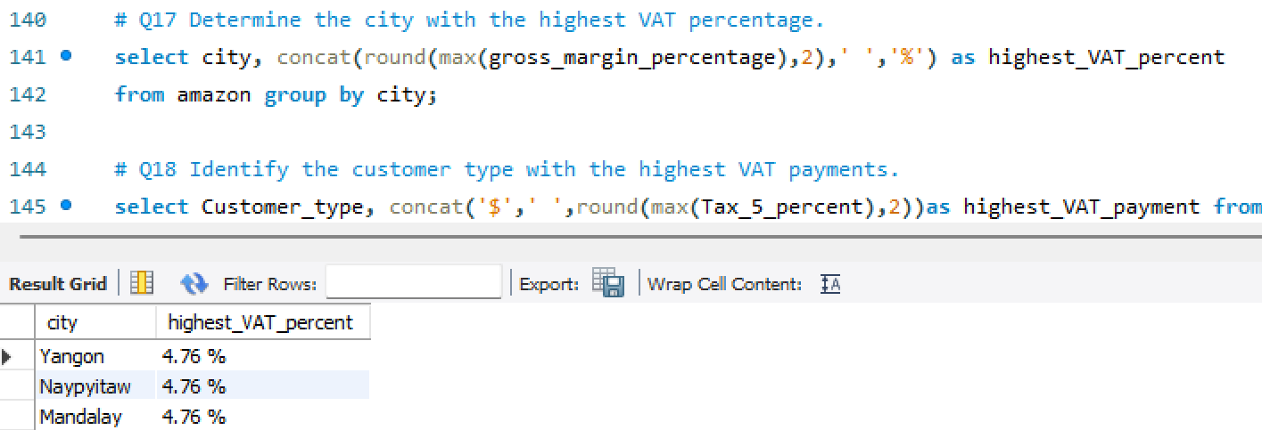
Determine the city with the highest VAT percentage.

Slide 22
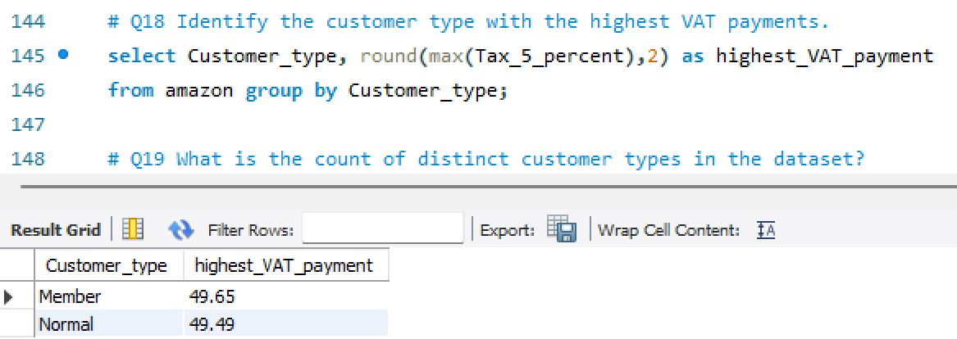
Identify the customer type with the highest VAT payments.

Slide 23
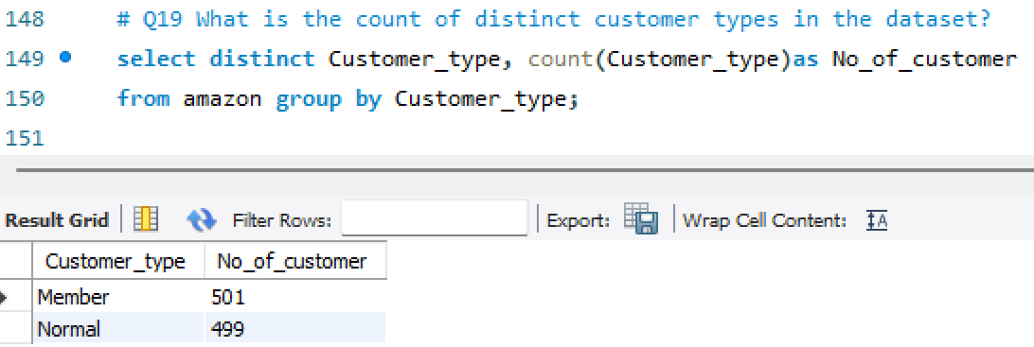
What is the count of distinct customer types in the dataset?

Slide 24
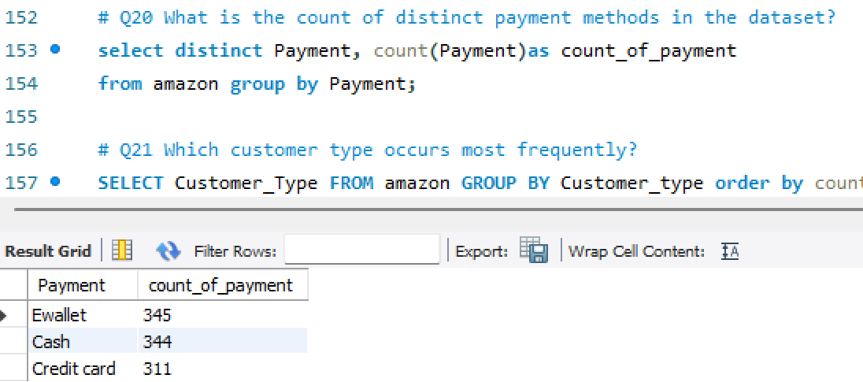
What is the count of distinct payment methods in the dataset?

Slide 25
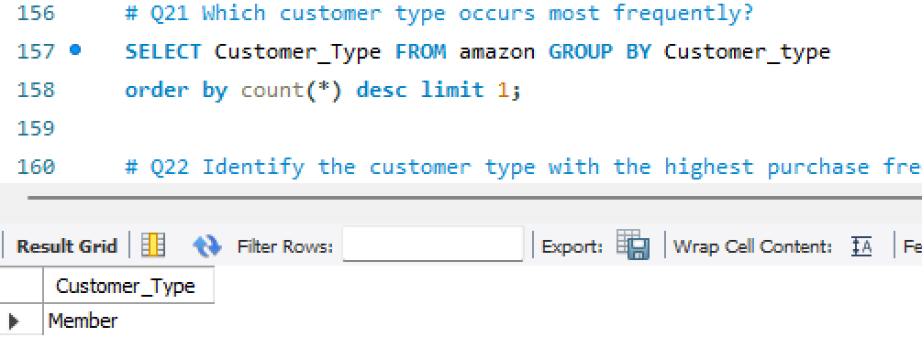
Which customer type occurs most frequently?

Slide 26
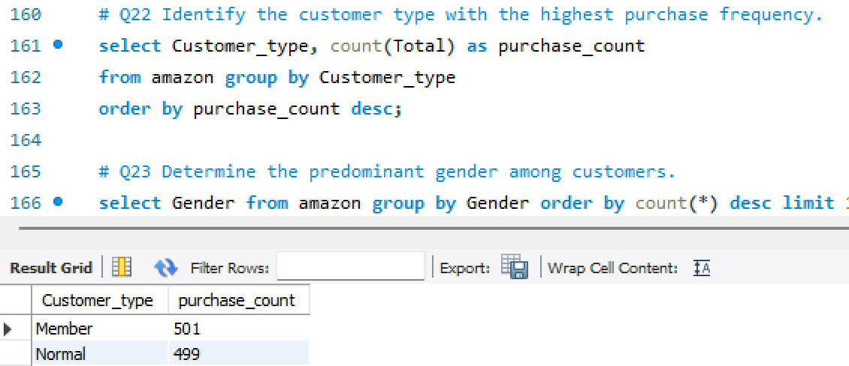
Identify the customer type with the highest purchase frequency.

Slide 27
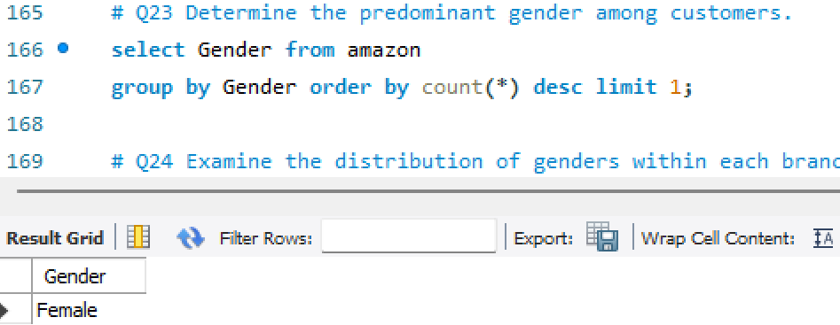
Determine the predominant gender among customers.

Slide 28
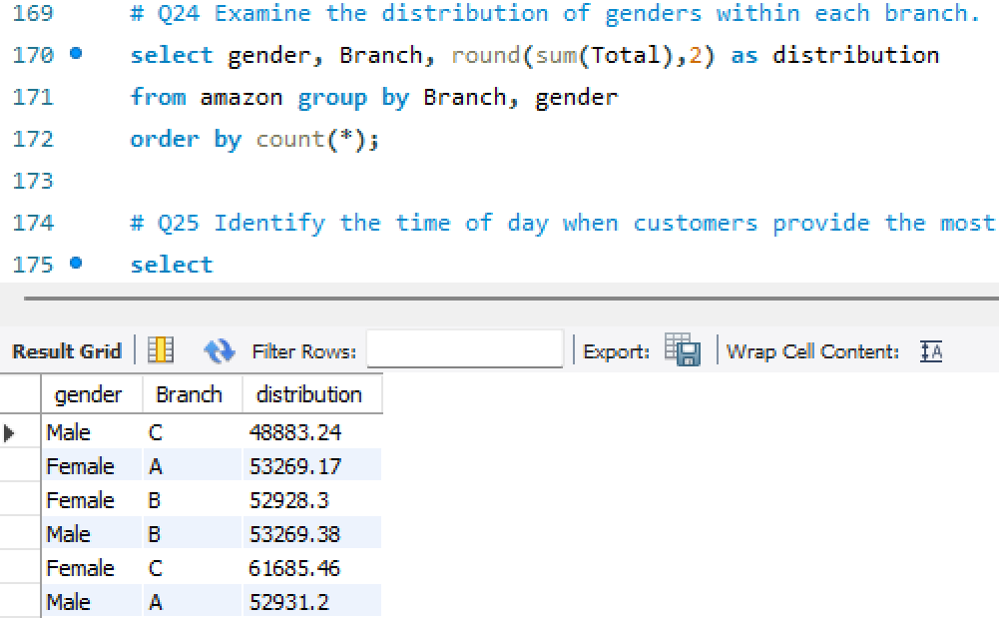
Examine the distribution of genders within each branch.

Slide 29
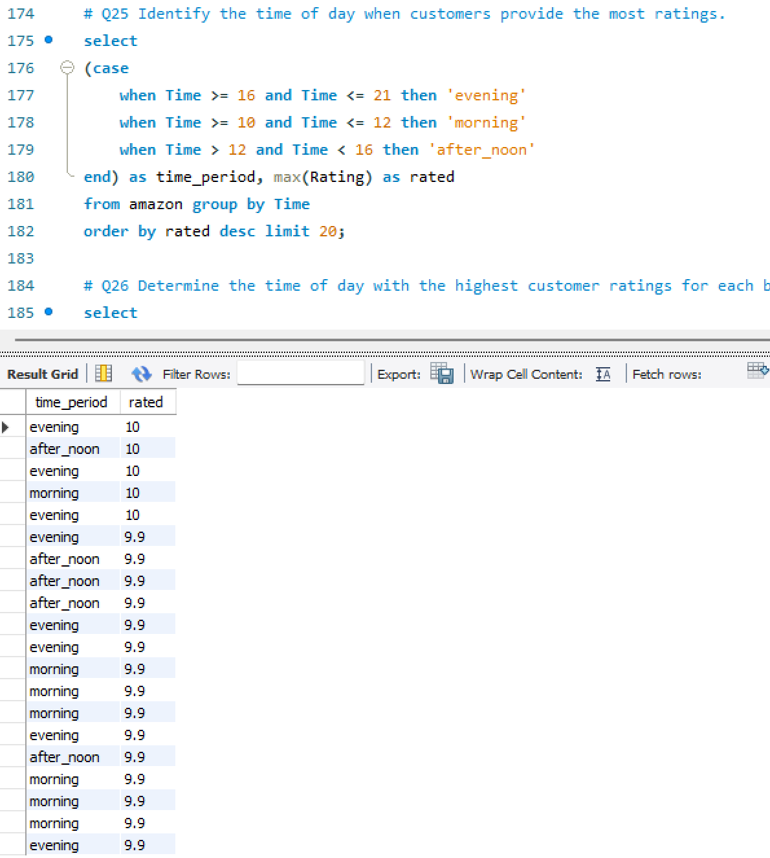
Identify the time of day when customers provide the most ratings.

Slide 30
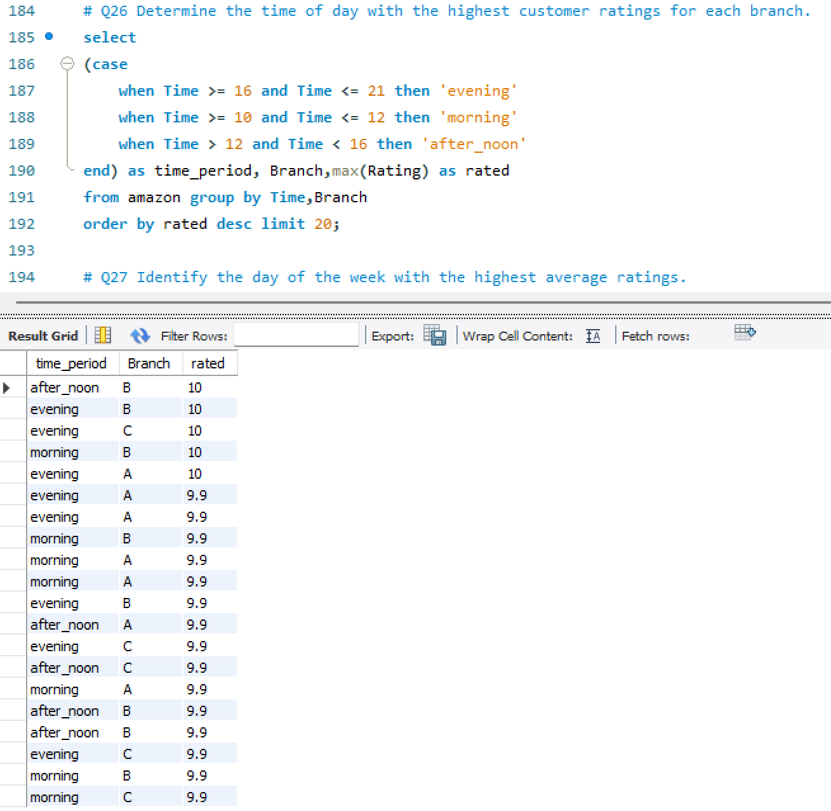
Determine the time of day with the highest customer ratings for each branch.

Slide 31
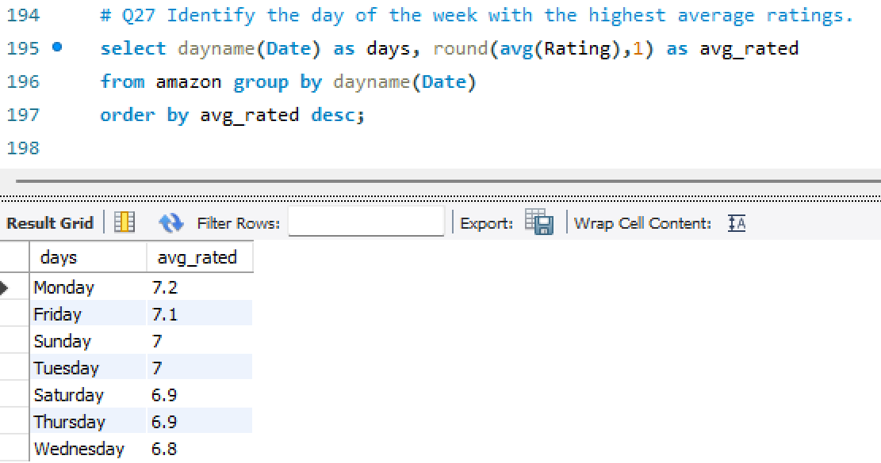
Identify the day of the week with the highest average ratings.

Slide 32
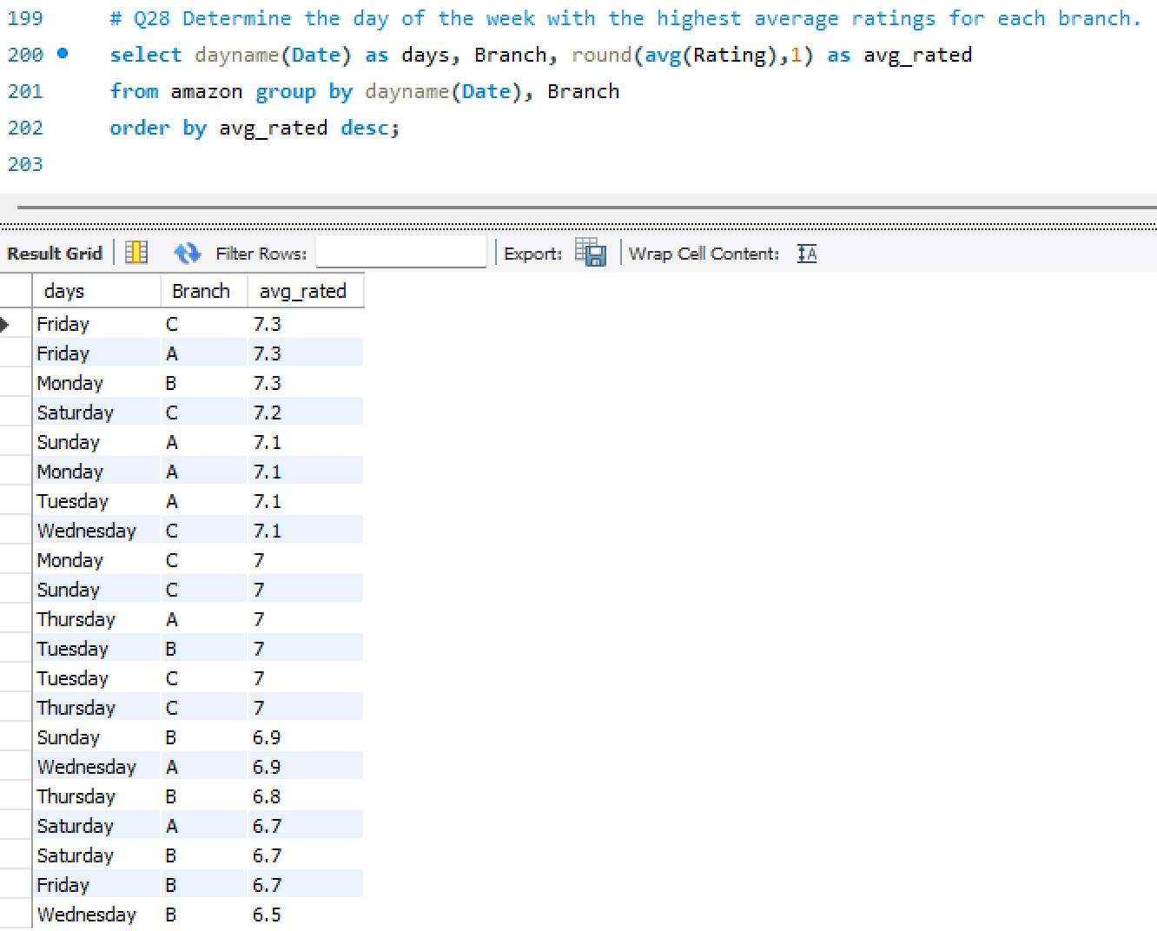
Determine the day of the week with the highest average ratings for each branch.

Slide 33
Product Analysis
Food and beverages
highest sailing product
highest tax paying product
highest revenue generated product
highest average rated product
Health & beauty
lowest sailing product
lowest tax paying product
lowest revenue generated product
Second highest average rated product
Home and Lifestyle: lowest average rating product

Slide 34
Sales Analysis
January
Highest revenue generated
Highest goods sold
February
Lowest revenue generated
Lowest goods sold
Most of the sale occurs between 4PM to 9PM on Saturday, Tuesday, Wednesday, Sunday
City & Branch
Naypyitaw(C branch) generate highest revenue
Mandalay(B branch) generate lowest revenue
C branch exceeded the average number of products sold
Payment Method
E-Wallet and Cash are most frequently used
Some of them use credit card

Slide 35
Customer Analysis
Most of the female members are frequently purchase product
Females frequently purchasing from C branch(profitable)
Males frequently purchasing from B branch(profitable)
Some females purchasing from A branch(less profitable)
Some Males purchasing from C branch(less profitable)
Most of the customer rated branch between 4PM to 9PM
Most of the time B branch get highest rated
Monday and Friday are the highest rated day

Slide 36
Improvement & Suggestions
Encourage customers to purchase from Mandalay(B Branch) by giving discounts and coupon’s
Health & beauty products line need to be improve sales by getting feedback from customers so make changes accordingly
Initiate special offer & discounts on festival in February to attract customers to increase sales
4-9pm are peak time for sale specially on Saturday and Tuesday so Encourage customers to purchase by showing upcoming offers, seasonal discount and membership offers to increase sales
Encourage customers to rate your product and branch so that can make better impact on customers to purchase your product from this branch

